Slide 1
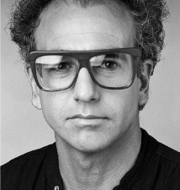
Introduction to Computer Science & Scratch
Hello World
Starting with Scratch
Mohamed Tamer Amen

Slide 2

Lecture 5 : Exception handling , Debugging & Libraries in Python

Slide 3
Python
Exception Handling, Debugging & Libraries Friday 3/3/2022
Error Types
1. Syntax Error
2. Value Error
3. try, except
4. Name Error
5. else
6. Debugging the Errors
Libraries/Modules
7. Modules
8. Packages
9. Introducing Import
10. Let’s use pyttsx3 module
11. Let’s use cowsay package
12. Modules Documentations

Slide 4
Error types
1. Syntax Error
2. Value Error
3. try, except
4. Name Error
5. else
6. Debugging the Errors

Slide 5
1- Syntax error
Introduction about “Exception” :
Exception occur to happen when something is gone wrong in your program
What’s kind of wrong do we mean?
well let’s see in the following code and see what will happen:

Slide 6
1- Syntax error
NO!
Code:
print(“hello world)
Can this code run ?
NO!!! , It can’t run and it will give a type of error called “Syntax error”
What is Syntax error? We will discuss this right now.

Slide 7
1- Syntax error
Syntax Error : mistake in the code you wrote , Such as spelling and punctuation errors, incorrect labels, and so on, which cause an error message to be generated by the compiler.
So in the previous code there was a mistake that we forgot to put the (quotes : ”) so the correct way to write the code and avoid the syntax error is : print (“Hello world”)
Now there is no syntax error

Slide 8
2- Value error
- Value error : is an exception that occurs when a function receives an argument of the correct data type but an inappropriate value. This error usually occurs in mathematical operations that require a certain kind of value
Example:
x = int( input (“what is x ? ”) )
print(f ”x is {x}” )
<<so in this example we will need the user to put an integer value and let’s see what will happen>>

Slide 9
2- Value error
Example:
x = int( input (“what is x ? ”) )
print(f ”x is {x}” )
In our code here if the user enter an integer value it will run as well
But , What will happen if the user entered a different type of variable ?
Ans : here the value error will appear as the value is inappropriate value for the code as we said:
x = int (….
, so any data type other than integer is value error

Slide 10
3- try ,except
try , except are considered a two blocks
try block : lets you test a block of code for errors. except block : lets you handle the error.
So we can define the two blocks by the following question:
Can I go and try to do something except if something goes wrong I can do something else instead?

Slide 11
3- try ,except
Example
try:
x = int( input (“what’s x ?”) )
print(f ”x is {x}”)
except Value Error:
print(“x is not an integer”)

Slide 12
3- try ,except
Example
try:
x = int( input (“what’s x ?”) )
print(f ”x is {x}”)
except Value Error:
print(“x is not an integer”)
So if the user try to enter another different data type other than integer the print(“x is not an integer”) message will appear instead of ValueError message.

Slide 13
4- Name Error
NameError : occurs when you try to use a variable, function, or module that doesn't exist or wasn't used in a valid way.
Some of the common mistakes that cause this error are:
Using a variable or function name that is yet to be defined.

Slide 14
4- Name Error
This code can run only if the variable x is integer , If any error occurred specially in initializing x it will lead to another error which is Name error and it happened because x isn’t saved due to it’s error in line 2 which lead to another error in line 6 as x isn’t initialized and I asked for a variable or function name that is yet to be defined.
As in previous Example:
try:
x = int( input (“what’s x ?”) )
print(f ”x is {x}”)
except Value Error:
print(“x is not an integer”)
print( f ”x is {x}” )

Slide 15
5- else
Is condition that you should if the first doesn’t as we studied before
So what will else help us for in this section?
As in the previous code there was a NameError occurred

Slide 16
4- Name Error
So let’s consider this code as 3 sections first I will see try section if it worked successfully or not
If it worked successfully go to else block
if it doesn’t work Successfully I do exception section and ignore else.
As in previous Example:
try:
x = int( input (“what’s x ?”) )
print(f ”x is {x}”)
except Value Error:
print(“x is not an integer”)
else:
print( f ”x is {x}” )

Slide 17
6- debugging the error:
Debugging : Is the process of detecting and removing of existing and potential errors (also called as 'bugs') in a software code that can cause it to behave unexpectedly or crash
Example:
def func1( a, b):
return a/b
def func2(x):
a=x
b=x-1
return func1 ( a, b)
In [1]:

Slide 18
6- debugging the error:
In [2]: func2(1)
There will be an error here ZeroDivisionError as a = 1 and b = 0 then we will go to func1(1,0) which will result 1/0 which lead to an error.
Conclusion: as we see that the code may appear fine and has no problem but sometimes some errors occurs from no where.
so debugging the error can solve this problem with three possibilities:
plain , context and verbose

Slide 19
6- debugging the error:
In [3]:
%xmode Plain
Exception reporting mode : plain
Traceback (most recent call)
func2(1)
In [4]:

Slide 20
6- debugging the error:
In [5]:
%xmode Verbose
Exception reporting mode : Verbose
Traceback (most recent call last)
Verbose is similar as plain but verbose add extra information and argume=nt to any function that are called
func2(1)
In [6]:

Slide 21
6- debugging the error:
In [5]:
%xmode Verbose
Exception reporting mode : Verbose
Traceback (most recent call last)
Verbose is similar as plain but verbose add extra information and argument to any function that are called

Slide 22
The code above:
For more information Resource code:
https://jakevdp.github.io/PythonDataScienceHandbook/01.06-errors-and-debugging.html#:~:text=Debugging%3A%20When%20Reading%20Tracebacks%20Is,causing%20a%20more%20difficult%20error.

Slide 23
Packages & Modules
1. Introducing Import
2. Modules Documentations
3. Let’s use pyttsx3 module
4. Packages
5. Let’s use cowsay package

Slide 24
Function
Function
Module
Function
Function

Slide 25
Modules
Modules
Package
Modules
Modules

Slide 26
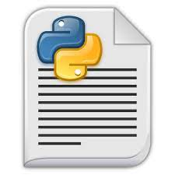
def function_name ( ):
…
…
def function_name ( ):
…
…
def function_name ( ):
…
…
Module

Slide 27
Does Modules Only Contain Function?
NO!
pi = 3.1415…
Math

Slide 28
Modules
A Python module is a file containing Python definitions and statements.
A module can define functions, classes, and variables.
Modules are self-contained software units which can be:
Re-used in other software
Executed independently
Easily identified between other units

Slide 29

Module
Module
Module

Slide 30
Package
A Python package, on the other hand, is a directory/folder that can potentially have multiple modules (files), and even sub-packages (more directories, more files).

Slide 31
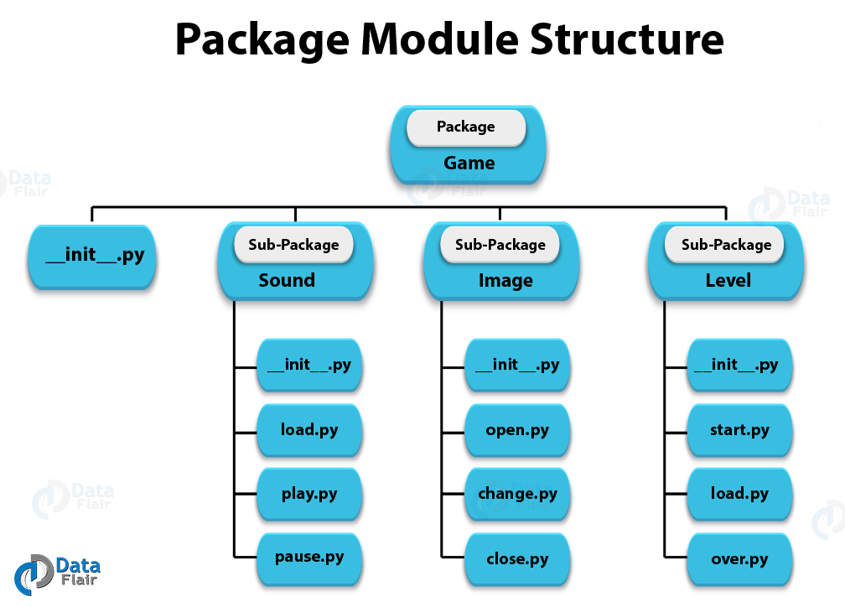

Slide 32
Since each modules are a collection of functions and it each can be executed on its own then a function is considered a module. (same goes for the classes)
Any python file you have ever created is considered a module

Slide 33
Importing Modules
Let’s import our first module and let the fun begin.
To use a module we need to:
First: Download the module
Second: import the module
Third: Check the module documentation

Slide 34
Module Documentation
It is a detailed summary about the module and what are the functions and variables are in this module, what are the parameters or each function, return type, … ,etc.

Slide 35
__init__.py
The __init__.py file lets the Python interpreter know that a directory contains code for a Python module.
An __init__.py file can be blank.
Without one, you cannot import modules from another folder into your project.
Let’s try our Package

Slide 36

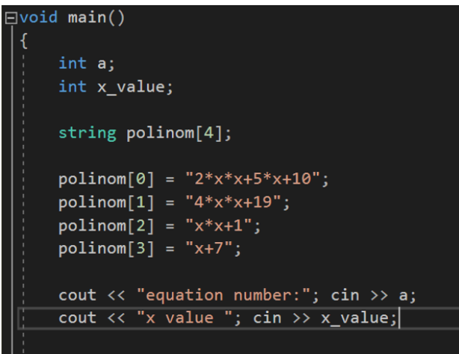
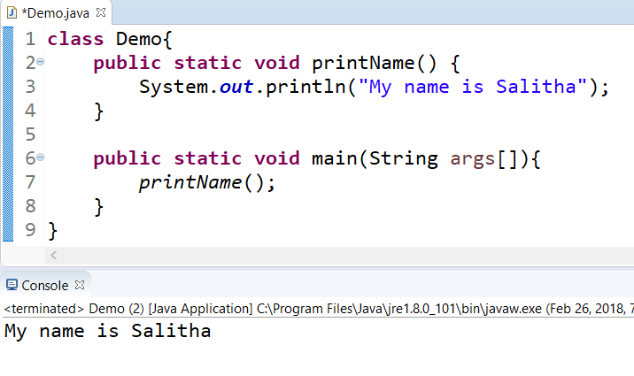
__main__
So what is main?
We notice that in other languages the code is written inside a block called main, but in python it is not!

Slide 37
__main__
In other programing languages main is a function that indicate the start of the running code, where if any function is not called by the main function it is not executed.
So main indicate where top level code that is currently executed.
In Python it is a bit different

Slide 38
__name__ variable
In python name is a variable that carries the value of the name of the file.
__name__ == cowsay
cowsay.py
__ name __ == Math
Math.py
__ name __ == mymodule
mymodule.py

Slide 39
__main__ variable
__main__ is the name of the environment where top-level code is run.
“Top-level code” is the first user-specified Python module that starts running.
It's “top-level” because it imports all other modules that the program needs.
Sometimes “top-level code” is called an entry point to the application.

Slide 40
If(__name__ == ‘__main__’)
Is used make a distinction between modules that represent:
A. Libraries
Functions
classes
Which we import into our code
B. The python file (or code) that currently run
in the console
Into which we can import the modules of A
Lets see some code

Slide 41
Thanks for listening and hope to see you next lecture

